Slide 1
RNN, LSTM and GRU

Slide 2
Recurrent Neural Network (RNN)

Slide 3

MOTIVATION
Do you know how Google’s autocomplete feature predicts the rest of the words a user is typing?

Slide 4
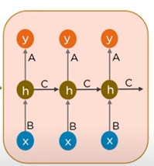



How does it predicts?
Angeles

Slide 5
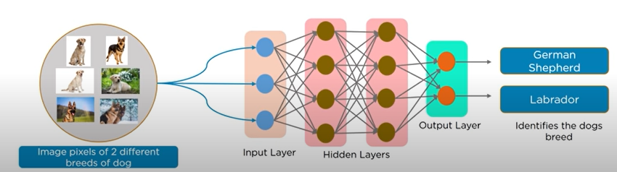
Neural networks
Neural Networks in deep learning, consists of different layers connected to each other and work on the structure and functions of a human brain, it learns from huge volumes of data and uses complex algorithms to train a neural network.

Slide 6
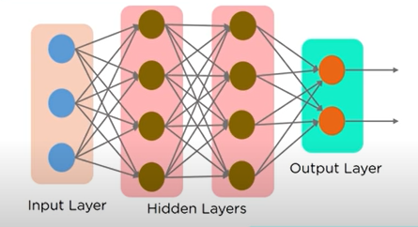
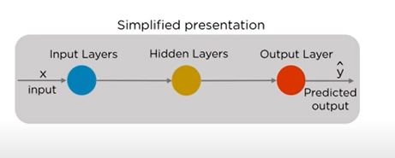
Feed forward neural network
In Feed Forward Neural Networks the information flows only in one direction , from the input nodes, through the hidden layer (if any) and to the output nodes. There are no cycles or loops in the network.

Slide 7
Why Recurrent neural network???
1) Cannot handle sequential data
2) considers only the current input
3) cannot memorize previous inputs

Slide 8
Getting targets when modeling sequences
When there is no separate target sequence, we can get a teaching signal by trying to predict the next term in the input sequence.
For temporal sequences there is a natural order for the predictions.
Consider you’re at a fancy dinner party, and someone spills cold drink on the tablecloth. The host, trying to maintain composure, turns to the guest and says, “Well, isn’t that just wonderful.” Here, “wonderful” is dripping with sarcasm, as it clearly doesn’t convey genuine praise but instead highlights the mishap in a sarcastic manner.

Slide 9
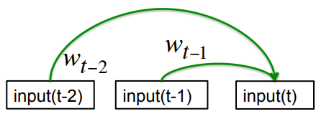
Memoryless models for sequences
Autoregressive models
Predict the next term in a sequence from a fixed number of previous terms using “delay taps”.

Slide 10
Beyond memoryless models
If we give our generative model some hidden state, and if we give this hidden state its own internal dynamics, we get a much more interesting kind of model.
– It can store information in its hidden state for a long time.

Slide 11
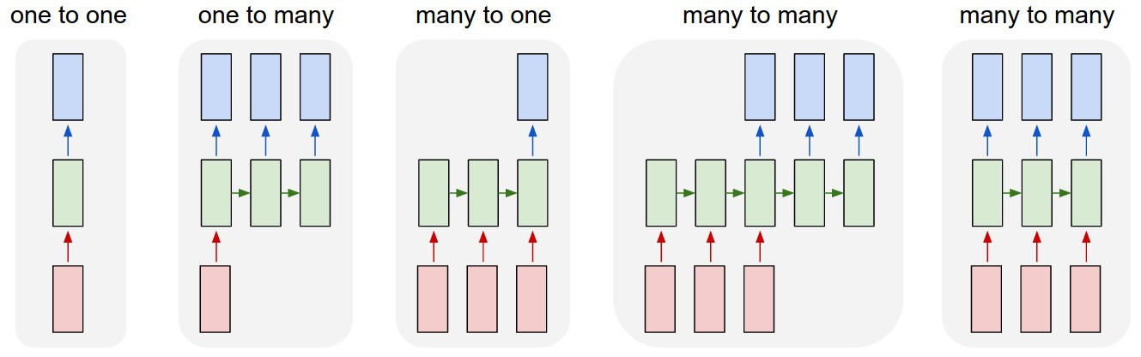
Sequence modelling
Image classification
Image captioning
Sentiment analysis
Machine translation
Video frame-by-frame classification

Slide 12
Recurrent neural networks
RNNs take the previous output or hidden states as inputs
The composite input at time t has some historical information about the happenings at time T< t
RNNs are useful as their intermediate states can store information about past inputs for a time that is not fixed a priori

Slide 13
Sample feed forward network
y₁
h₁
x₁
t = 1

Slide 14
Sample RNN
y₃
y₂
h₃
h₂
x₃
y₁
t = 3
x₂
h₁
t = 2
x₁
t = 1

Slide 15
Sample RNN
y₃
y₂
h₃
h₂
x₃
y₁
t = 3
x₂
h₁
t = 2
x₁
t = 1

Slide 16
Rnn basic concept
The network is given one input at a time.
It is combined with the hidden state into a vector
This vector goes through the tanh activation
The output is the new hidden state

Slide 17
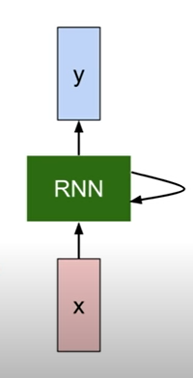
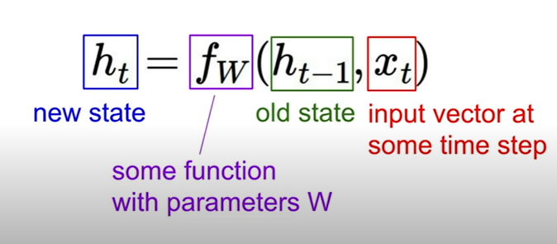
Recurrent neural network
We can process a sequence of vector x by applying a recurrence formula at every time step:

Slide 18
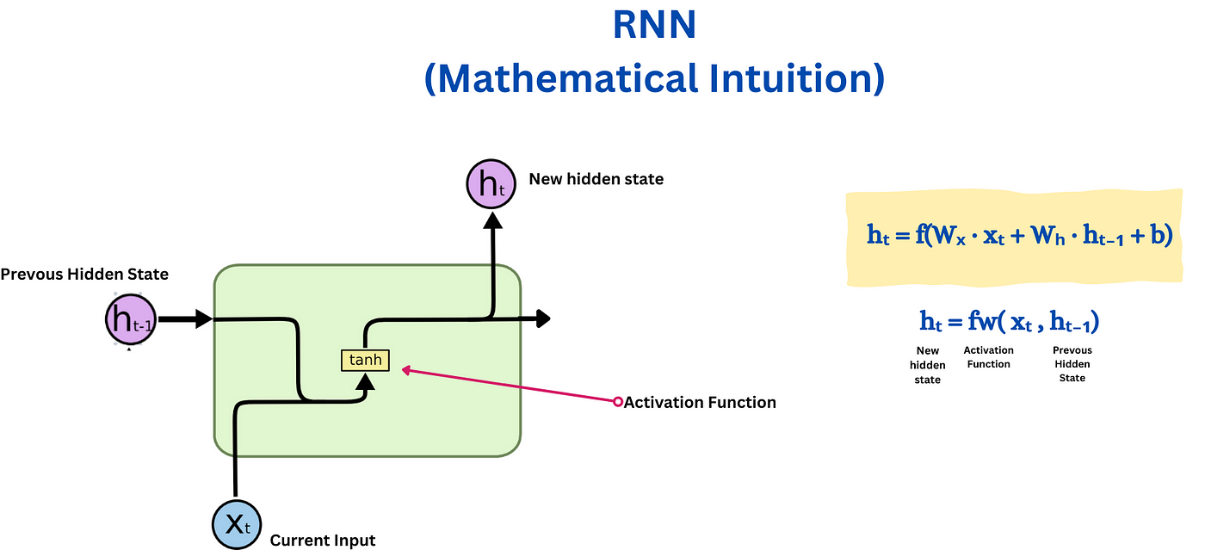
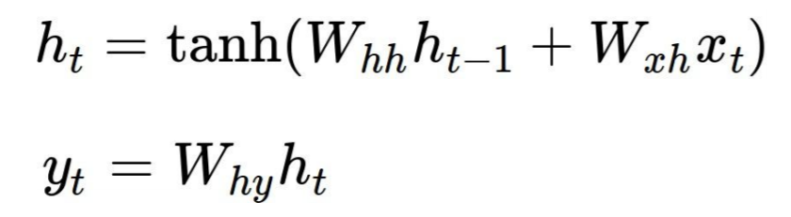

Slide 19
Vanishing/exploding gradient
Backpropagation in RNNs, known as Backpropagation Through Time (BPTT), extends the conventional backpropagation method by incorporating the temporal dimension of sequences.
In BPTT, the network's weights are updated based on the gradients of the loss function computed across all time steps of the sequence.
During this process, the RNN unfolds over time, creating a computational graph where each time step is treated as a separate layer.
Gradients are calculated by unrolling the RNN through all these time steps and then propagated backward through this unrolled network. This is different from conventional backpropagation used in feedforward neural networks, which only considers a single, fixed layer structure.

Slide 20
Vanishing/exploding gradient
In RNNs, the gradients must traverse a dynamic, time-expanded graph, making the process more complex and susceptible to issues like vanishing or exploding gradients.
Mathematically, this happens because gradients are recursively multiplied by the same weight matrix and activation function derivatives, which can either diminish or amplify their magnitude significantly over many time steps.

Slide 21
Vanishing/exploding gradient
Vanishing Gradients: In RNNs, during backpropagation through time (BPTT), the gradients of the loss function with respect to the weights are calculated by multiplying the gradient from the next time step by the derivative of the activation function and the weight matrix. If these derivatives are small (for example, in the case of the sigmoid or tanh activation functions, which have derivatives less than 1), the gradients can diminish exponentially as they propagate backward through each time step. As a result, the network learns very slowly or not at all for long sequences, making it difficult to capture long-term dependencies.
Exploding Gradients: On the flip side, if the derivatives are large (greater than 1), the gradients can grow exponentially during backpropagation. This rapid increase can cause the model weights to become too large, leading to numerical instability and causing the model to fail to converge.

Slide 22
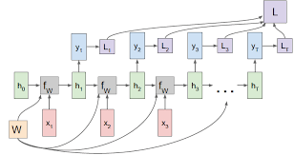
RNN Computational Graph

Slide 23
Rnn: types
The 3 most common types of Recurrent Neural Networks are
1. Vanilla RNN
2. LSTM (Long Short-Term Memory)
3. GRU (Gated Recurrent Units)

Slide 24
Long Short Term Memory Network (LSTM)

Slide 25

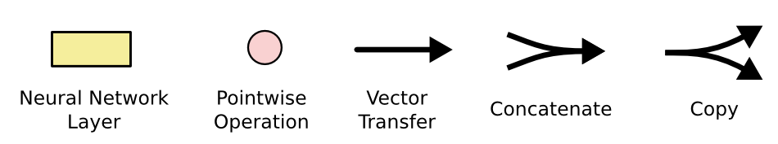
Long short term memory (lstm)
Cell States
Hidden States
Input Gates
Forget Gates
Output Gates

Slide 26
LSTM
Long Short Term Memory Network is an advanced RNN, a sequential network, that allows information to persist.
It is capable of handling the vanishing gradient problem faced by RNN. Let’s say while watching a video you remember the previous scene or while reading a book you know what happened in the earlier chapter. Similarly RNNs work, they remember the previous information and use it for processing the current input. The shortcoming of RNN is, they can not remember Long term dependencies due to vanishing gradient.
LSTMs are explicitly designed to avoid long-term dependency problems.

Slide 27
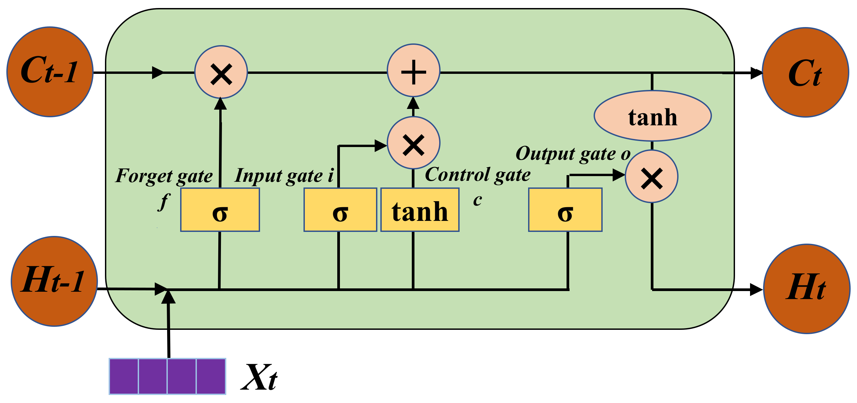
Long short term memory (lstm)

Slide 28
LSTM
Review from PDF

Slide 29
Cell state vs hidden state
The cell state acts as a long-term memory that carries relevant information across many time steps, allowing the network to retain and update information over long sequences.
It is modified through operations like the forget and update gates, which control what information to keep or discard.
In contrast, the hidden state represents the short-term memory of the network, capturing the current state of the model based on the recent input and cell state.
It is updated at each time step and is used to generate the output of the LSTM unit.

Slide 30
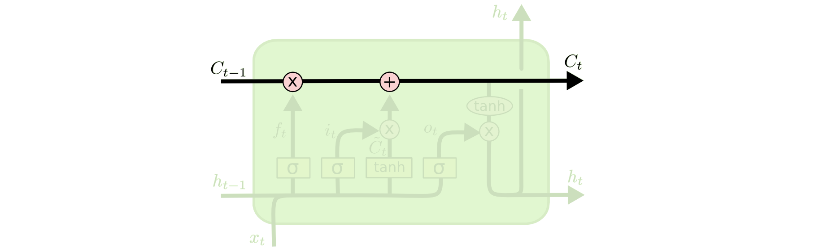
LSTM Cell state
Maintains a vector C_{t} that is the same dimensionality as the hidden state, h_{t}
Information can be added or deleted from this state vector via the forget and input gates.

Slide 31
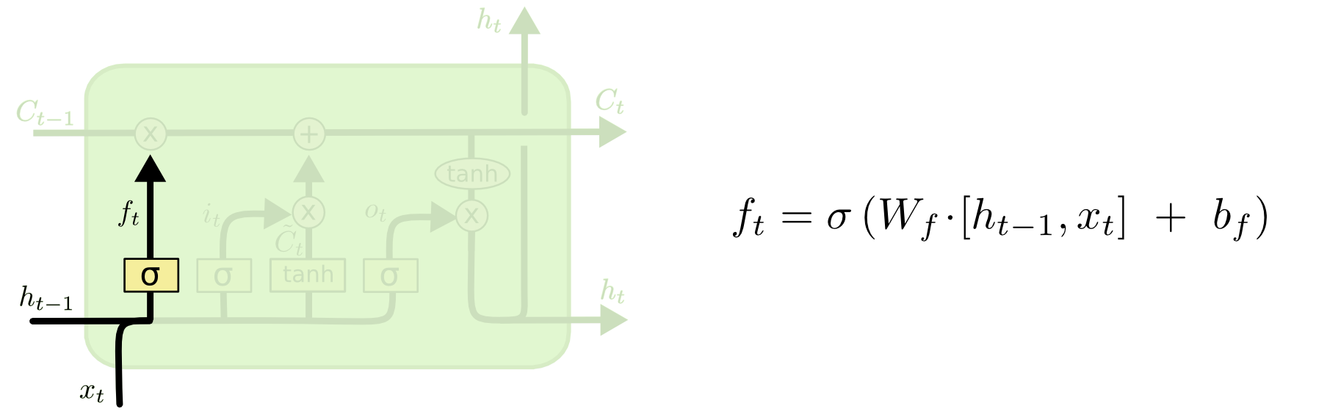
Lstm : Forget gate
Forget gate computes a 0-1 value using a logistic sigmoid output function from the input, x_{t}, and the current hidden state, h_{t}:

Slide 32
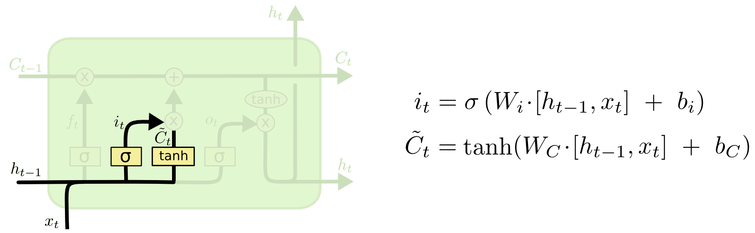
Lstm : input gate
First, determine which entries in the cell state to update by computing 0-1 sigmoid output.
Then determine what amount to add/subtract from these entries

Slide 33
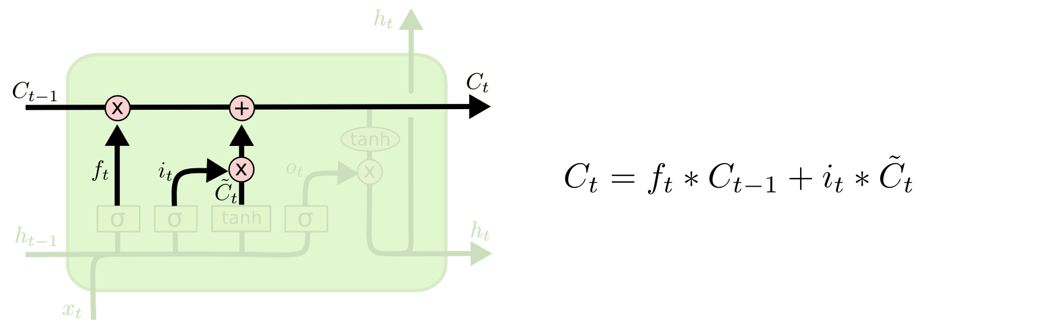
Updating the cell state
Cell state is updated by using component-wise vector multiply to "forget" and vector addition to "input" new information.

Slide 34
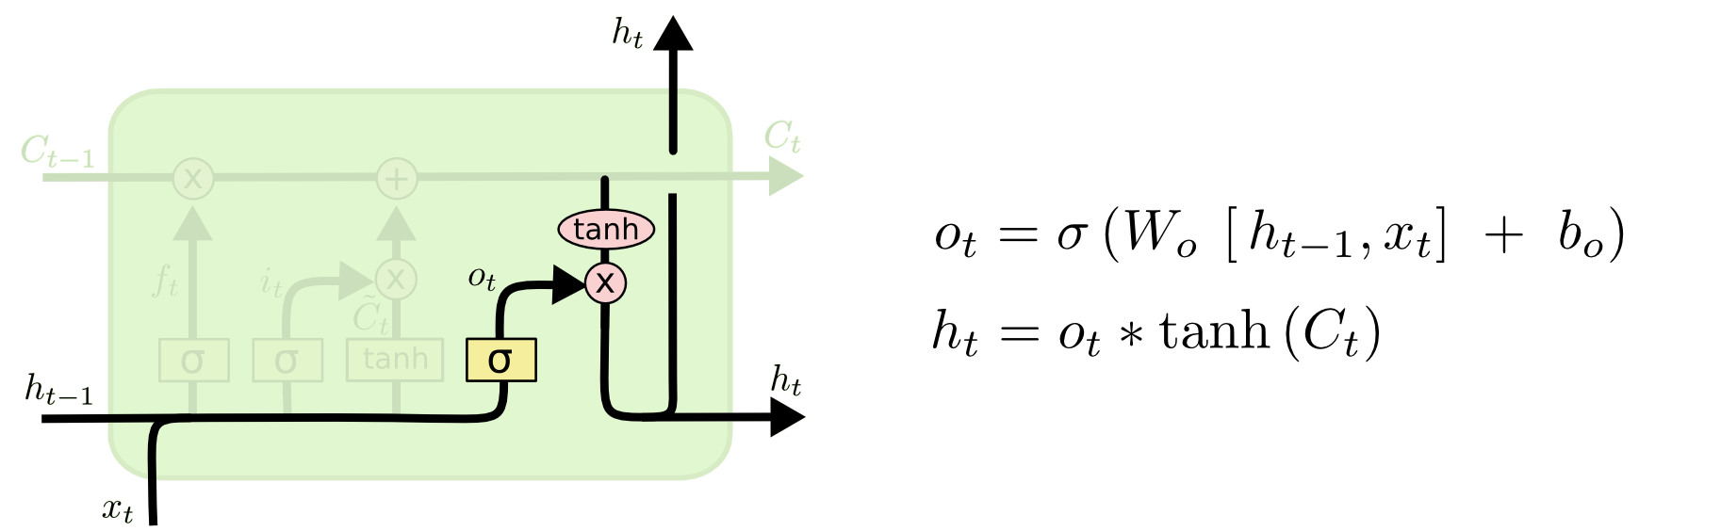
Lstm : output gate
Output gate computes a sigmoid function of the input and current hidden state to determine which elements of the cell state to "output".

Slide 35
Long short term memory (lstm)

Slide 36
Gated Recurrent Units (GRU)

Slide 37
GRU(Gated Recurrent Unit)
GRUs are a variation of RNNs & known for handling sequential data effectively.
A GRU unit is similar in structure to a long short-term memory (LSTM) cell, another type of RNN cell.
GRUs consist of several gates and an internal state that helps the network maintain and update information over time.
Gates:
Update Gate (z): Manages what to keep from the previous state.
Reset Gate (r): Handles what to forget from the current state.
New Memory Content: Contains information to be incorporated into the memory.

Slide 38
Cont…
Operation:
At each time step, the GRU unit calculates these gates and updates its internal state and memory.
The update gate (z) determines how much of the previous state to keep and how much of the new candidate state to add.
The reset gate (r) decides which parts of the current state to forget.
The new memory content is then combined with the previous state to form the updated state.

Slide 39
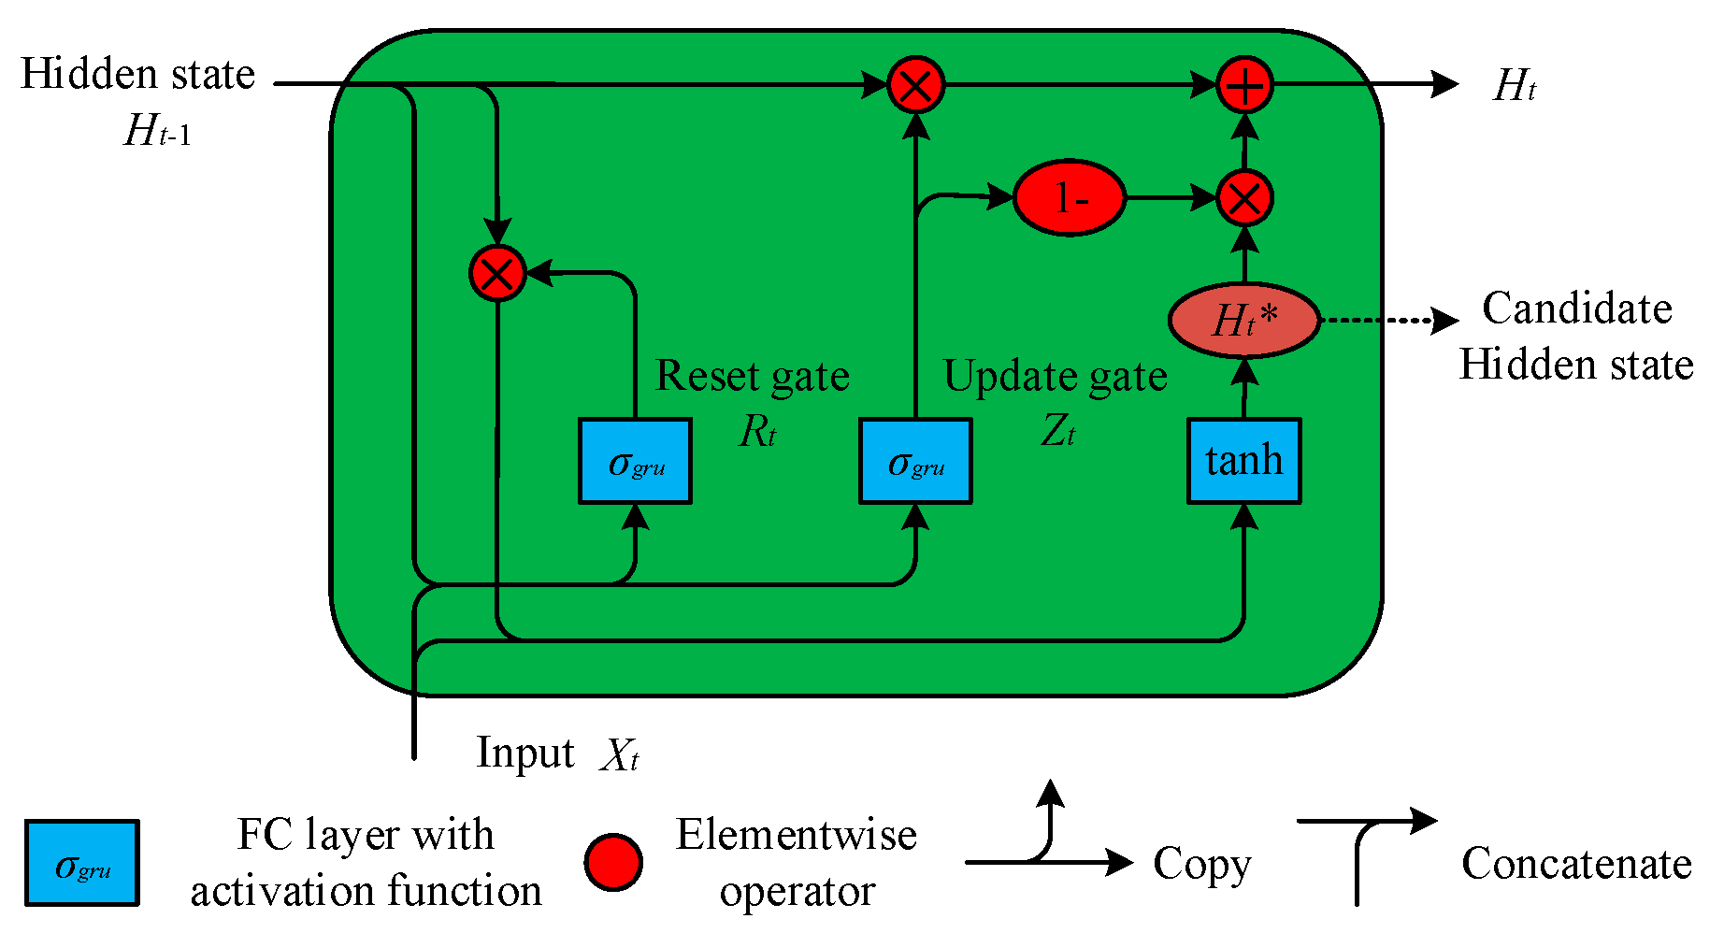
Cont…

Slide 40
Uses of Recurrent Networks

Slide 41
Practical Implications
Time Series Analysis
Forecasting Future Values
Stock Market Predictions: Predicting future stock prices based on historical data.
Weather Forecasting: Predicting future weather conditions (temperature, precipitation) from past weather data.
Demand Forecasting: Estimating future demand for products based on historical sales data.
Anomaly Detection
Fraud Detection: Identifying unusual patterns in financial transactions that may indicate fraudulent activity.
Machine Health Monitoring: Detecting abnormal patterns in sensor data from machinery to predict failures.
Signal Processing
Speech Analysis: Analyzing and processing spoken language signals for various applications like emotion recognition.
Biomedical Signal Analysis: Monitoring and interpreting physiological signals, such as ECG or EEG, to diagnose health conditions.
Trend Analysis
Economic Indicators: Understanding trends in economic indicators (GDP, inflation rates) to inform policy or investment decisions.
Retail Trends: Analyzing sales data to identify changing consumer preferences and adjust strategies accordingly.

Slide 42
Practical Implications
Natural Language Processing (NLP)
Text Generation
Completing the sentences – next word generation.
Machine Translation
Language Translation: Translating text from one language to another while maintaining context and meaning.
Multilingual Text Processing: Handling text in multiple languages within a single model, enabling applications like multilingual search engines.
Sentiment Analysis
Social Media Monitoring: Analyzing public sentiment on social media platforms to gauge public opinion on various topics.
Customer Feedback: Understanding the sentiment behind customer reviews and feedback to improve products and services.

Slide 43
Practical Implications
Natural Language Processing (NLP)
Spam Detection: Identifying and filtering out spam emails or messages.
Topic Categorization: Classifying documents into predefined categories or topics for better organization and retrieval.
Named Entity Recognition (NER)
Information Extraction: Identifying and categorizing entities such as names, dates, and locations within text for structured data extraction.
Knowledge Graph Construction: Building and enriching knowledge graphs by extracting and linking entities from unstructured text.
Part-of-Speech Tagging
Grammar Analysis: Assigning grammatical tags to each word in a sentence to understand sentence structure and improve parsing accuracy.
Text-to-Speech Systems: Enhancing text-to-speech systems by understanding the grammatical role of words to produce more natural speech output.

